Slide 1
TODO
Lada’s tests -> approval test (of the list) -> better printing
Full printed story -> whitespace -> json
Pretty printed json -> inline -> everywhere
everywhere -> single instance -> some can’t convert
dual conversations (.and) -> some can’t convert v2 -> setting state

Slide 2
Better Testing with Approvals
Llewellyn Falco
Lada Kesseler

Slide 3
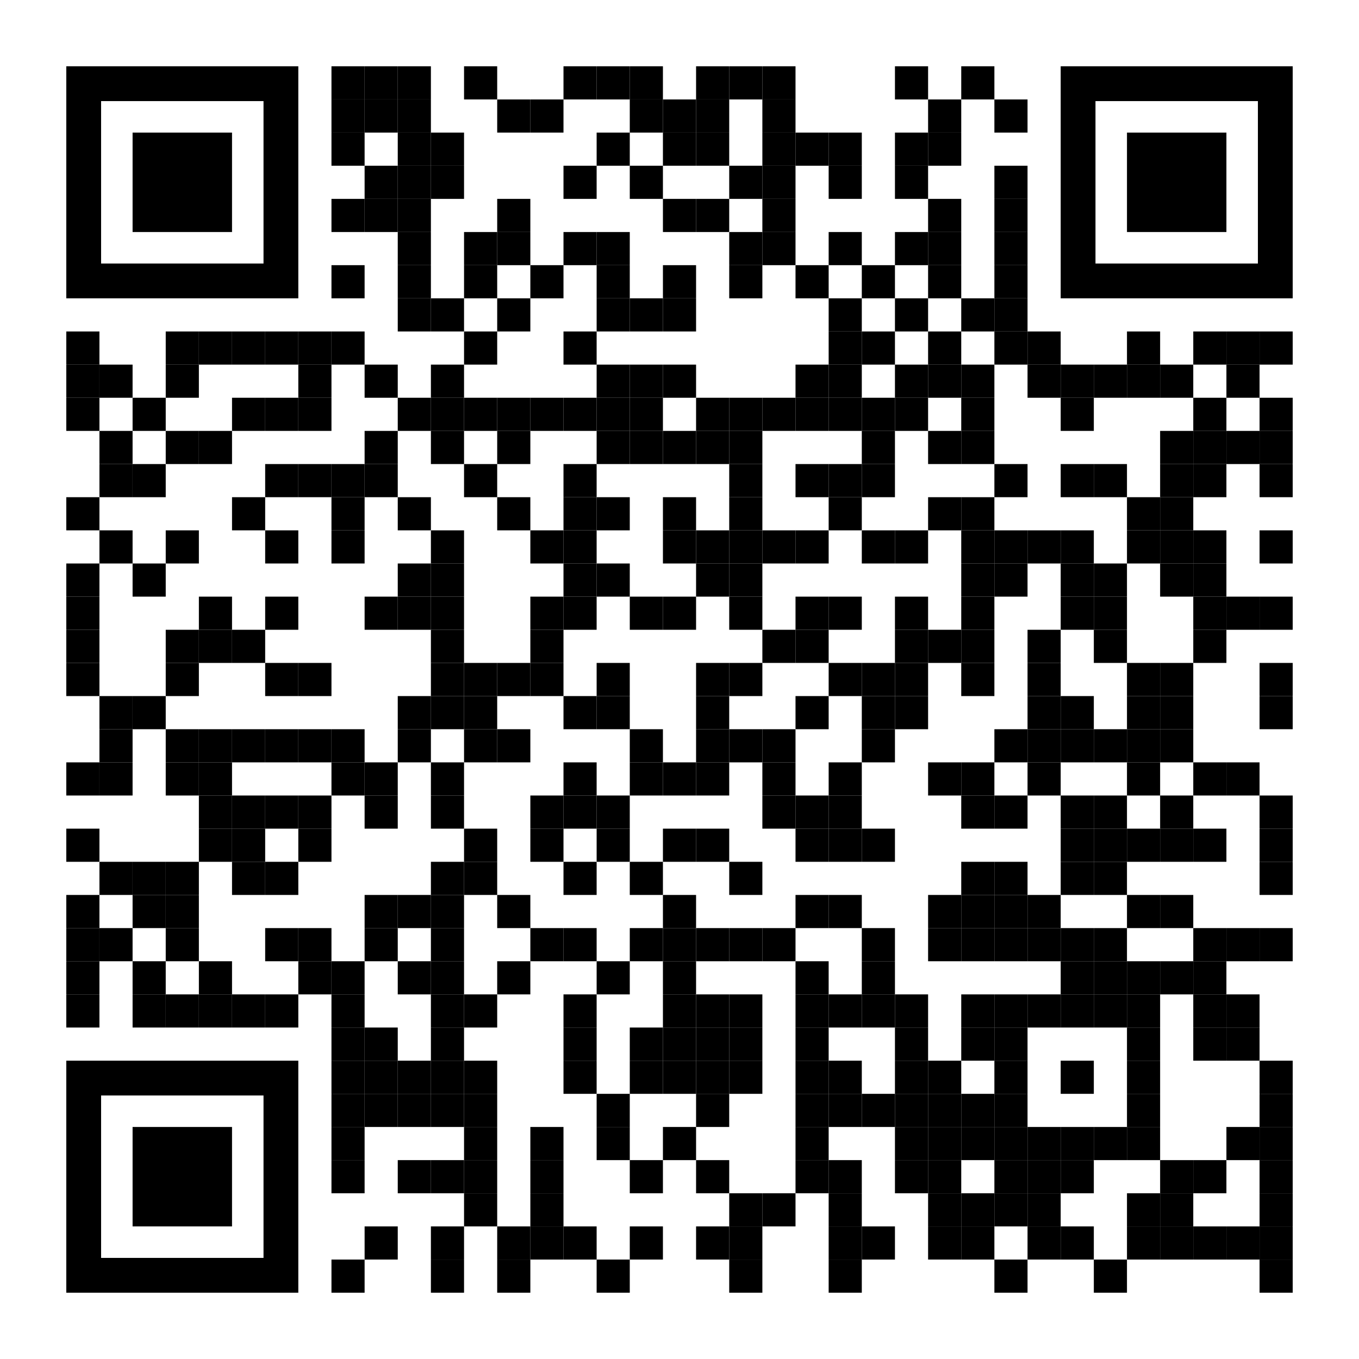
Resources
Notes:
https://github.com/isidore/Talks/blob/master/BetterTestingWithApprovals.md

Slide 4

..
..
Clear
Expressive
Simple

Slide 5

In the beginning...

Slide 6
code

Slide 7
Problem:
What the test does is confusing

Slide 8
New Concept:
Testing Circle

Slide 9
// Create side (0,0) – (3,4)
// Verify length
Whiteboard
English
Testing Circle
Result
Code
Side (0,0) – (3,4) length = 5
Side s = new Side(0,0,3,4);
Approvals.Verify(s + “ length = “ +s.Length);

Slide 10
Chat
[Customer]
hi
[Bot]
Hi there! I'm your virtual assistant.
What would you like to do today?
Notes:
we put the focus on what it is that we're testing, and not the setup of the test

Slide 11
Chat
[Customer]
hi
[Bot]
Hi there! I'm your virtual assistant.
What would you like to do today?
Whiteboard
English
Testing Circle
Result
Code

Slide 12
Chat
[Customer]
hi
[Bot]
Hi there! I'm your virtual assistant.
What would you like to do today?
// customer says ‘hi’
// verify conversation
Whiteboard
English
Testing Circle
Result
Code

Slide 13
Chat
[Customer]
hi
[Bot]
Hi there! I'm your virtual assistant.
What would you like to do today?
// customer says ‘hi’
// verify conversation
Whiteboard
English
Testing Circle
Result
Code
String userMessage = "hi"; verifyConversation(userMessage);

Slide 14
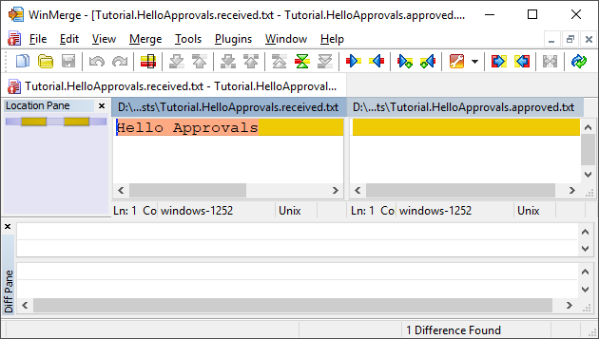
New Concept:
Approval Tests
Test + approved output

Slide 15
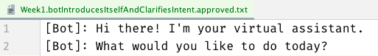
Chat
[Customer]
hi
[Bot]
Hi there! I'm your virtual assistant.
What would you like to do today?
// customer says ‘hi’
// verify conversation
Whiteboard
English
Testing Circle
Result
Code
String userMessage = "hi"; verifyConversation(userMessage);

Slide 16
Chat
[Customer]
hi
[Bot]
Hi there! I'm your virtual assistant.
What would you like to do today?
// customer says ‘hi’
// verify conversation
Whiteboard
English
Testing Circle
Result
Code
[Customer]: hi
String userMessage = "hi"; verifyConversation(userMessage);

Slide 17
Week 1
What happened
Notes:
Pay attention to the testing circle
Create convenience functions to hide unnecessary details

Slide 18
Complex
Tests
ApprovalTests
Testing Circle

Slide 19
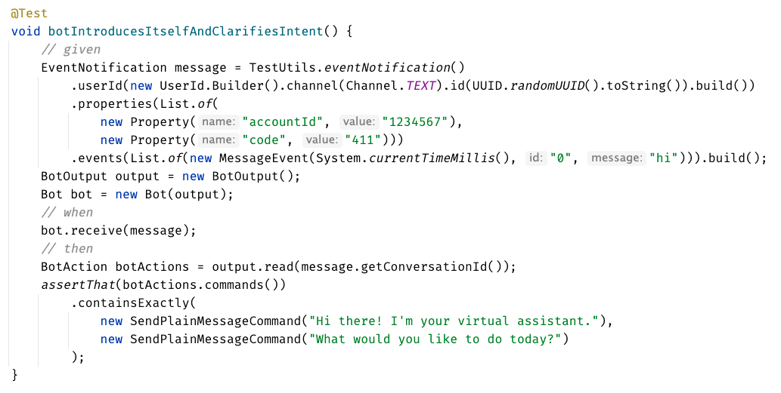

Slide 20
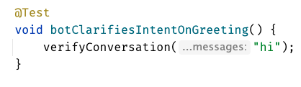
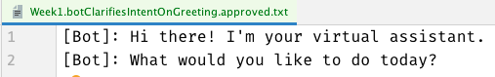

Slide 22
Week 1
learnings
Convenience Functions
ApprovalTests
Testing Circle
verifyConversation("hi");
Notes:
Pay attention to the testing circle
Create convenience functions to hide unnecessary details

Slide 23
...later next week...

Slide 24
code

Slide 25
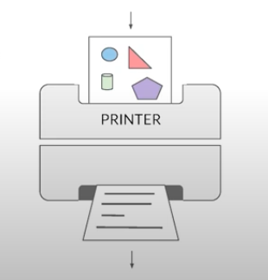
New Concept:
Printers
@EmillyBache

Slide 26
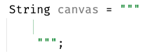
New Concept:
Story Board

Slide 27
Problem:
Lack of clarity in the test code output

Slide 28
Chat
[Customer]
hi
[Bot]
Hi there! I'm your virtual assistant.
What would you like to do today?
[Customer]
pay bill
[Bot]
Are you a customer?
Yes, I'm a customer No, I'm not

Slide 29
[Customer]: hi [ Bot]: Hi there! I'm your virtual assistant. [ Bot]: What would you like to do today? [Customer]: pay bill [ Bot]: Let me try to help you. [ Bot]: { "content": { "type": "vertical", "elements": [ { "type": "text", "text": "Are you a customer?", "tooltip": "text tooltip" }, { "type": "horizontal", "elements": [ { "type": "button", "title": "Yes", "click": { "actions": [ { "type": "publishText", "text": "Yes, I'm a customer" } ] } }, { "type": "button", "title": "No", "click": { "actions": [ { "type": "publishText", "text": "No, I'm not" } ] } } ] } ] } }
Chat
[Customer]
hi
[Bot]
Hi there! I'm your virtual assistant.
What would you like to do today?
[Customer]
pay bill
[Bot]
Are you a customer?
Yes, I'm a customer No, I'm not

Slide 30
Week 1
What happened
Notes:
Pay attention to the testing circle
Create convenience functions to hide unnecessary details

Slide 31

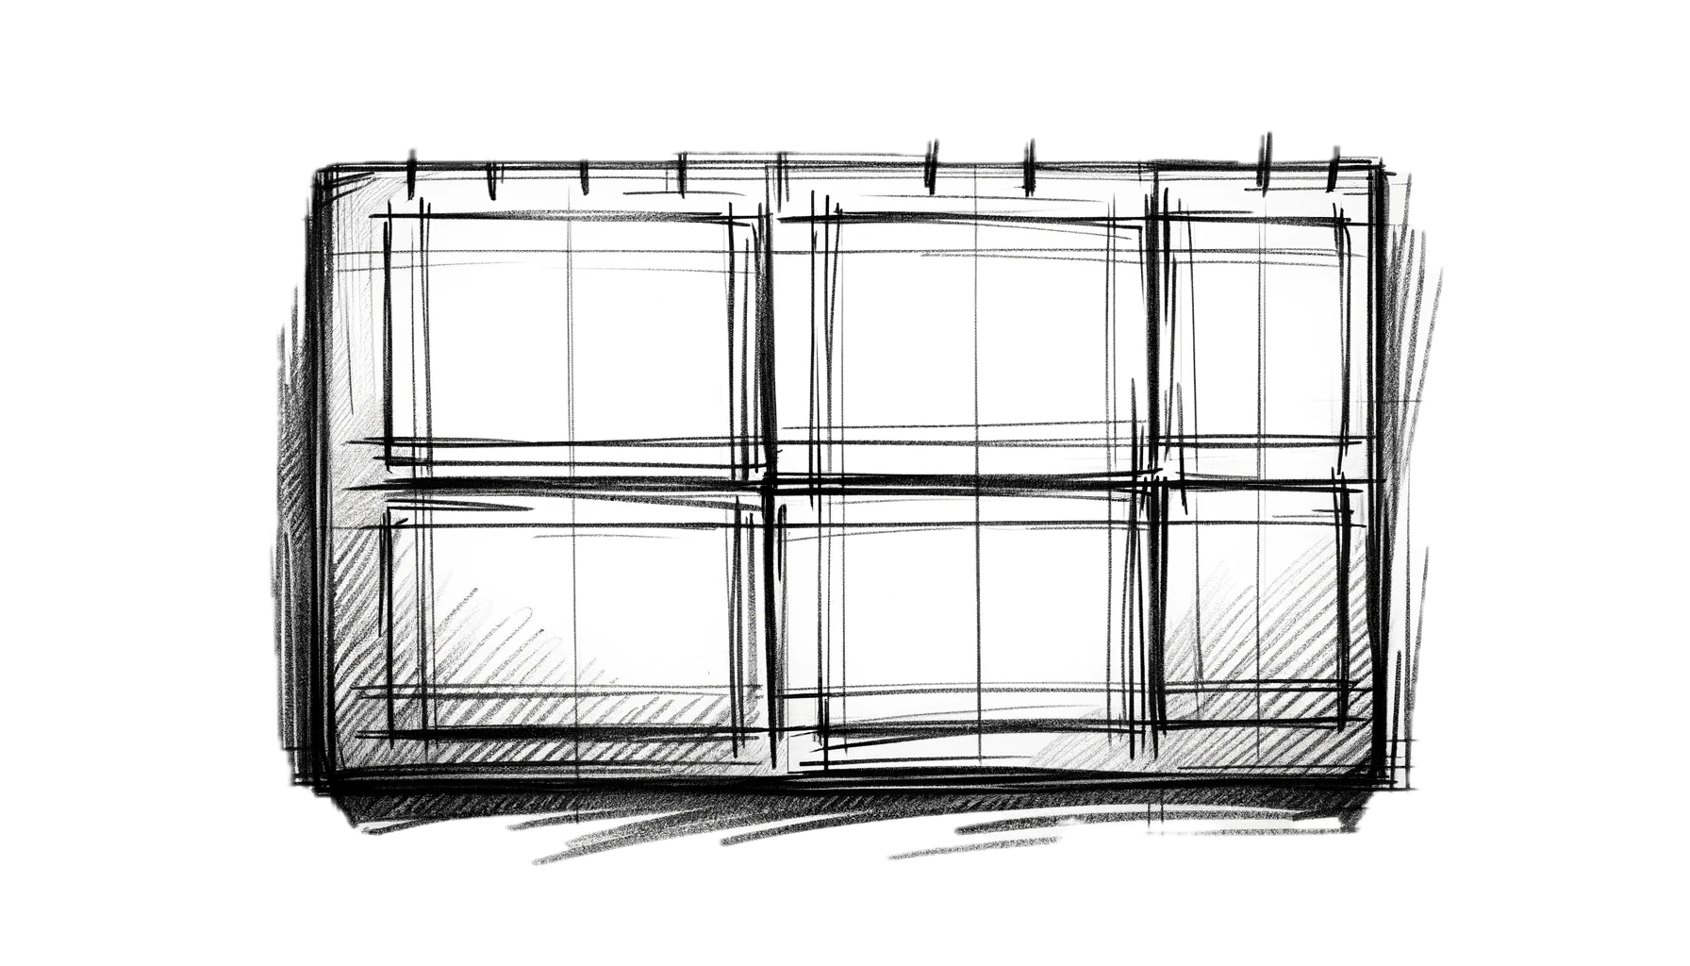
Complex
Tests
ApprovalTests
Testing Circle
Printers
+ Storyboard
JSON

Slide 32
Formatting
[Customer]: hi [Bot]: Hi there! I'm your virtual assistant. [Bot]: What would you like to do today?
[Customer]: hi [ Bot]: Hi there! I'm your virtual assistant. [ Bot]: What would you like to do today?

Slide 33
Formatting
[Customer]: hi [Bot]: Hi there! I'm your virtual assistant. [Bot]: What would you like to do today? [Customer]: hi [Bot]: Hmmm, tell me a little more so I can help you. What would you like to do today? [Customer]: hi [Bot]: Let me try to help you. [Bot]: Are you a customer? 1) Yes, I'm a customer 2) No, I'm not
[Customer]: hi
[ Bot]: Hi there! I'm your virtual assistant. [ Bot]: What would you like to do today? [Customer]: hi [ Bot]: Hmmm, tell me a little more so I can help you. [ ]: What would you like to do today? [Customer]: hi [ Bot]: Let me try to help you. [ Bot]: Are you a customer? [ ]: 1) Yes, I'm a customer [ ]: 2) No, I'm not

Slide 34
[Customer]: hi [ Bot]: Hi there! I'm your virtual assistant. [ Bot]: What would you like to do today? [Customer]: pay bill [ Bot]: Let me try to help you. [ Bot]: { "content": { "type": "vertical", "elements": [ { "type": "text", "text": "Are you a customer?", "tooltip": "text tooltip" }, { "type": "horizontal", "elements": [ { "type": "button", "title": "Yes", "click": { "actions": [ { "type": "publishText", "text": "Yes, I'm a customer" } ] } }, { "type": "button", "title": "No", "click": { "actions": [ { "type": "publishText", "text": "No, I'm not" } ] } } ] } ] } }
[Customer]: hi [ Bot]: Hi there! I'm your virtual assistant. [ Bot]: What would you like to do today? [Customer]: pay bill [ Bot]: Let me try to help you. [ Bot]: Are you a customer? [ ]: 1) Yes, I'm a customer [ ]: 2) No, I'm not

Slide 35
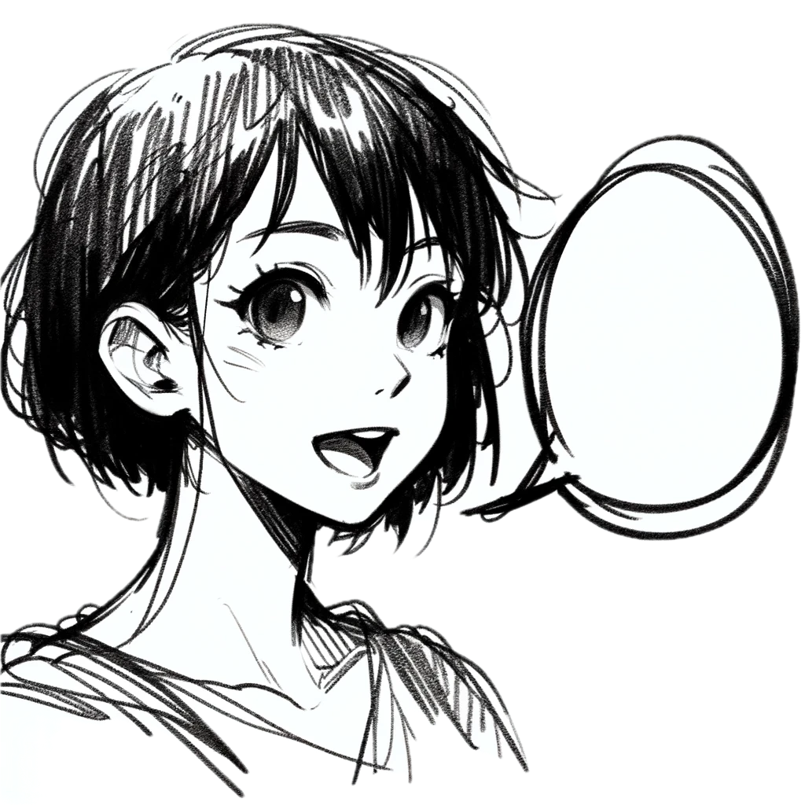
Week 2
learnings
Storytelling
Storyboard
Printers
Formatting
[Customer]: talk to an operator [ Bot]: Hi there! I'm your virtual assistant. [ Bot]: Let me try to help you. [ Bot]: Are you a customer? [ ]: 1) Yes, I'm a customer [ ]: 2) No, I'm not
Notes:
Pay attention to the testing circle
Create convenience functions to hide unnecessary details

Slide 36
...later next week...

Slide 37
code

Slide 38
Problem:
Too many .approved. files

Slide 39
New Concept:
Inline Approvals

Slide 40
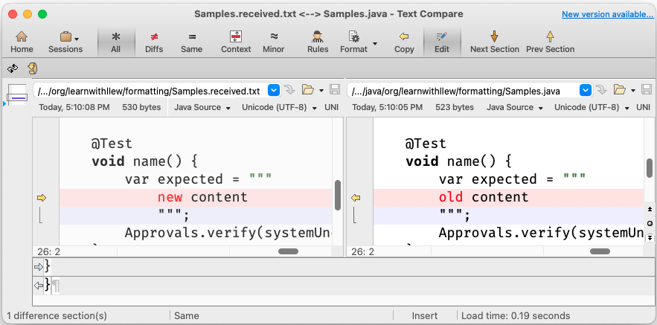
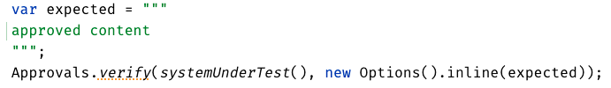
New Concept:
Inline Approvals
“Look mom, no files!”
Possible new source file
Original source file
Approved output
How to invoke
Pressing this modifies
your source code

Slide 41
Week 3
What happened
Notes:
Pay attention to the testing circle
Create convenience functions to hide unnecessary details

Slide 42
Complex
Tests
ApprovalTests
Testing Circle
Printers
+ Storyboard
JSON
Inline

Slide 43
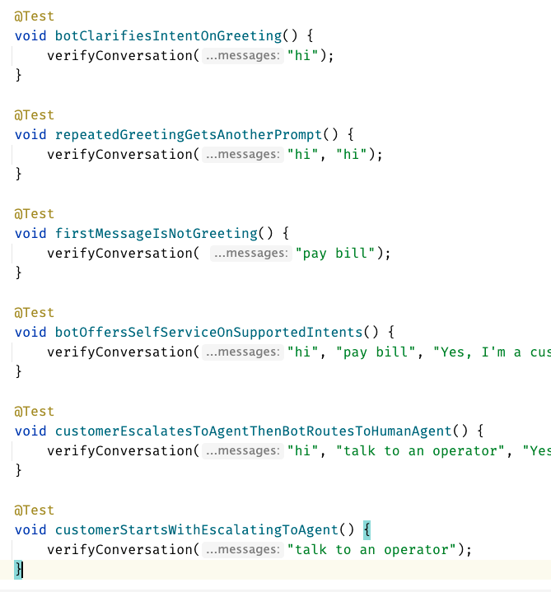
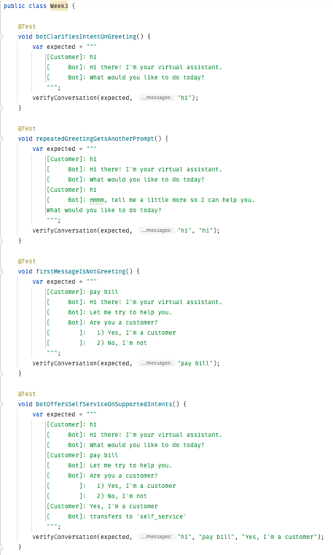
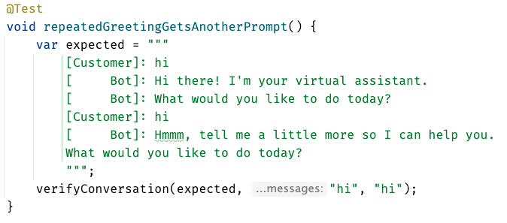
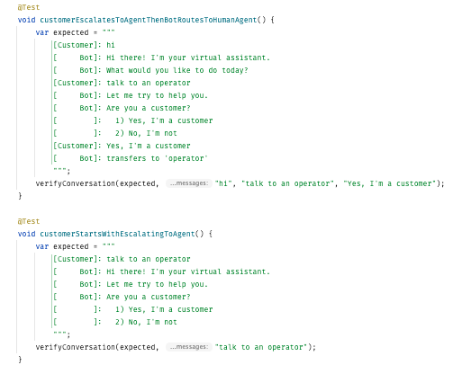
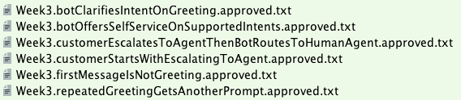

Slide 44
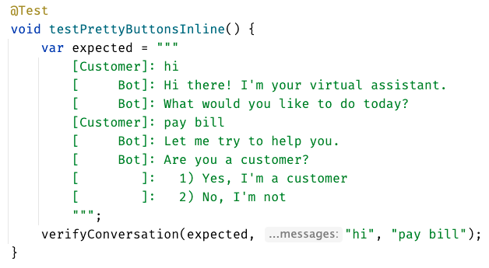
inline - everything in test

Slide 45
Week 3
learnings
Inline
Notes:
Pay attention to the testing circle
Create convenience functions to hide unnecessary details

Slide 46
...later next week...

Slide 47
code
Notes:
Hey Llewellyn, look what I did

Slide 48
Problem:
Can’t see the overall test strategy
hard to see if you’re missing cases...

Slide 49
New Concept:
verifyAll()

Slide 50
New Concept:
many of one

Slide 51
Week 4
What happened
Notes:
Pay attention to the testing circle
Create convenience functions to hide unnecessary details

Slide 52
Complex
Tests
ApprovalTests
Testing Circle
Printers
+ Storyboard
JSON
Verify all
Inline

Slide 53
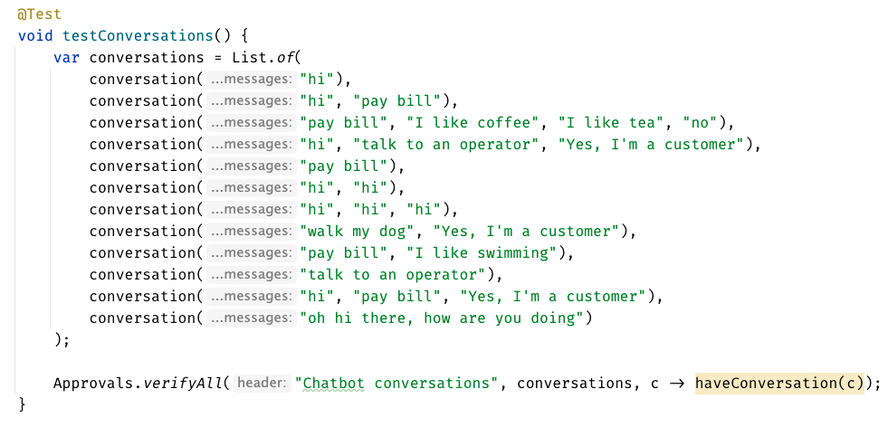

Slide 54
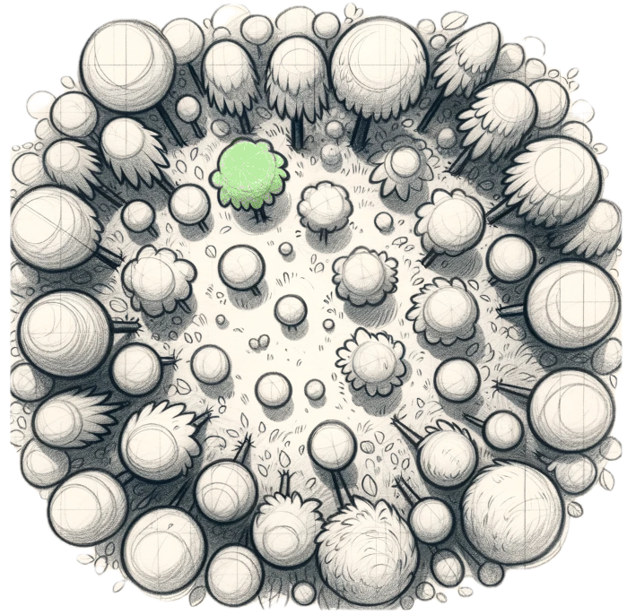
Week 4
learnings
Verify all
See the forest AND the trees
Notes:
Pay attention to the testing circle
Create convenience functions to hide unnecessary details

Slide 55
...later next week...

Slide 56
code
Notes:
Hey Llewellyn, look what I did

Slide 57
Problem:
95% of tests are together
but 5% are alone...

Slide 58
New Concept:
Custom test scenario builders
creating Domain-Specific Language (DSLs)

Slide 59
Week 5
What happened
Notes:
Pay attention to the testing circle
Create convenience functions to hide unnecessary details

Slide 60
Complex
Tests
ApprovalTests
Testing Circle
Printers
+ Storyboard
JSON
Verify all
Inline
domain DSL

Slide 61
var conversation1 = conversation("pay bill", "Yes, I'm a customer"); var conversation2 = conversation("pay bill"); var conversations = List.of(conversation1, conversation2);
conversation("pay bill", "No, I'm not") .thenConversation("pay bill")

Slide 62
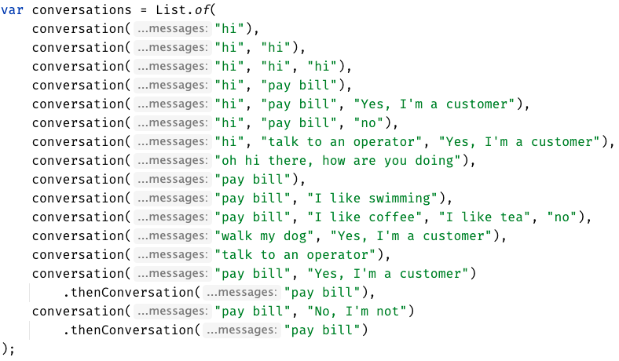

Slide 63
Week 5
learnings
See the forest AND the trees
(consistency)
Domain DSL
Notes:
Invest in APIs that make it easier to express test scenarios

Slide 64
...later next week...

Slide 65
code
Notes:
Hey Llewellyn, look what I did

Slide 66
Problem:
The tests are only for developers

Slide 67
New Concept:
Alternative .approved. files
new Options().forFile().withExtension(".md")
Notes:
stakeholders

Slide 68
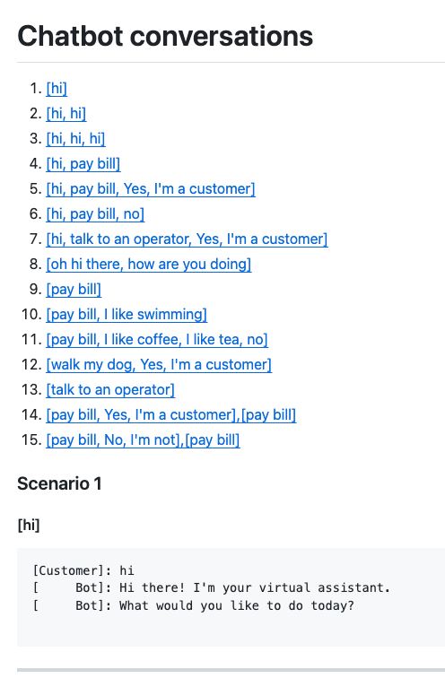
Complex
Tests
ApprovalTests
Testing Circle
Printers
+ Storyboard
markdown
Tests
work as Documentation
JSON
Verify all
Inline
domain DSL

Slide 69
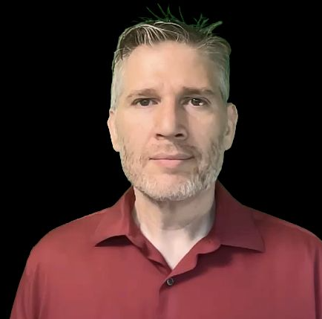
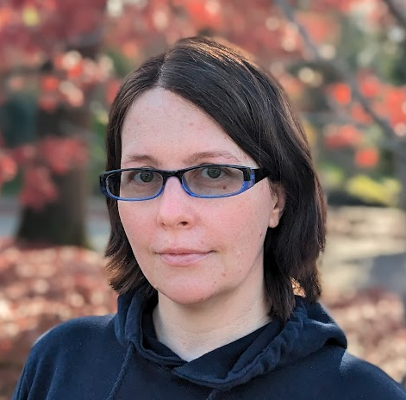
Resources
Thank you!
Llewellyn Falco
Lada Kesseler
Please connect on LinkedIn
Notes:
https://github.com/isidore/Talks/blob/master/BetterTestingWithApprovals.md

Slide 70
Chat
[Customer]
hi
[Bot]
Hi there! I'm your virtual assistant.
What would you like to do today?
Whiteboard
English
Testing Circle
Result
Code

Slide 71
Test.approved.txt
[Bot]: Hi there! I'm your virtual assistant. [Bot]: What would you like to do today?

Slide 72
var expected = """ [Customer]: hi [ Bot]: Hi there! I'm your virtual assistant. [ Bot]: What would you like to do today? """; verifyConversations(expected, "hi");

Slide 73
var conversations = List.of( conversation("hi"), conversation("hi", "hi"), conversation("hi", "hi", "hi"), conversation("hi", "pay bill"), conversation("hi", "pay bill", "Yes, I'm a customer"), conversation("hi", "pay bill", "no"), conversation("hi", "talk to an operator", "Yes, I'm a customer"), conversation("oh hi there, how are you doing"), conversation("pay bill"), conversation("pay bill", "I like swimming"), conversation("pay bill", "I like coffee", "I like tea", "no"), conversation("walk my dog", "Yes, I'm a customer"), conversation("talk to an operator") );
conversation("pay bill", "No, I'm not") .thenConversation("pay bill")

Slide 74
Complex
Tests
Approval
Tests
Test
Circle
Printers & Story Board
document
that is usable by stakeholders
JSON
markdown
verify all
expressive domain dsl
Inline

Slide 75
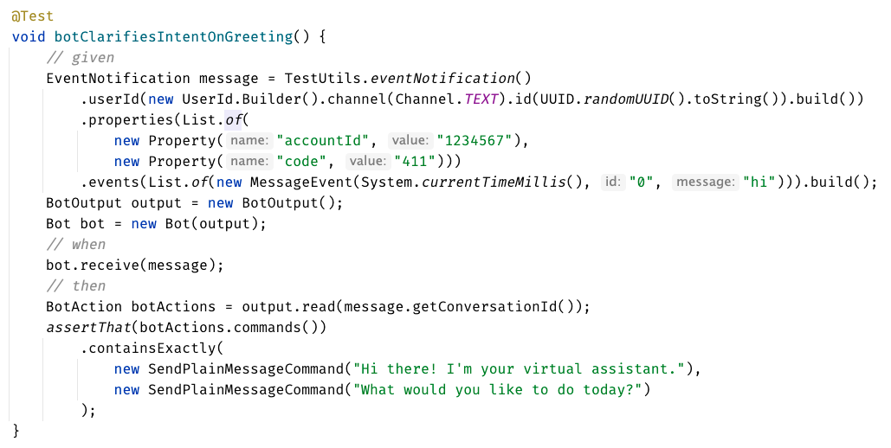
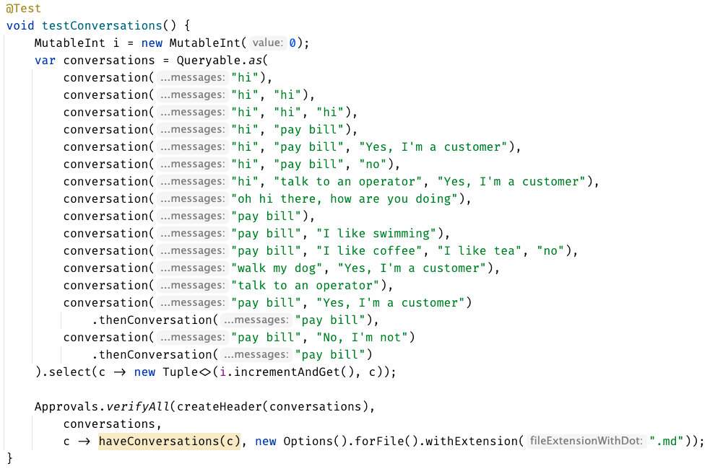

Slide 77
can see only
up to here
foggy
as the details disappear,
we get to see the next layer
person

Slide 78
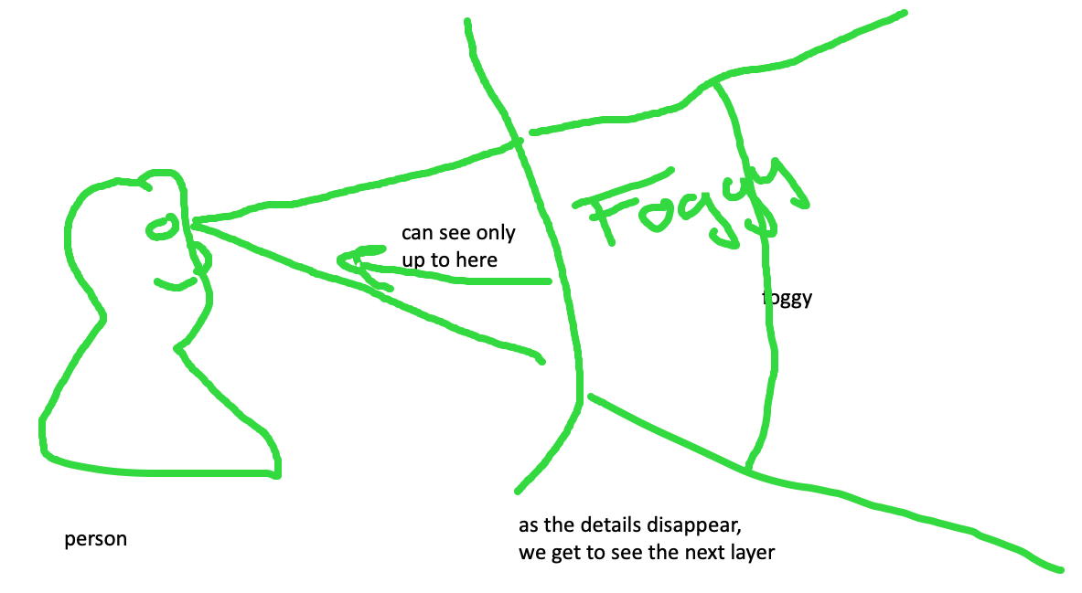
feedback loop – too hard and impossible is the same thing, stop to look

Slide 79
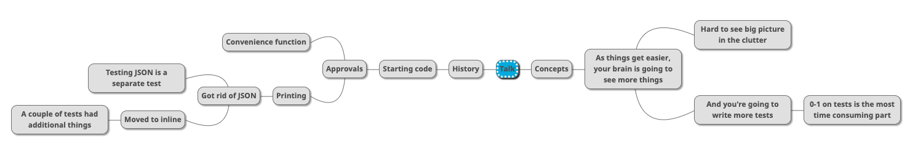

Slide 80
Rest Calls

Slide 81
Consider paths we took:
wordy Java tests
made a printer
made a good printer – not a json: Json test // TODO the json tests
made the inlining – makes it easier to read the whole test better
did multiple conversations
now we can see individual tests, but we can’t see the big picture – so we moved it to the uber test – can delete the other files

Slide 82
Original
@Test public void shouldGetCustomerFromService() { // given accountType = CustomerAccountTypeInfo.builder().account(ACCOUNT_ID).accountType(”PERSONAL").subscription(”MONTHLY").build(); when(responseEntity.getBody()).thenReturn(accountType); // when CustomerAccount result = customerService.retrieveAccount(ACCOUNT_ID); // then CustomerAccount expectedCustomerAccount = new CustomerAccount(ACCOUNT_ID, CustomerPaymentType.MONTHLY, "PERSONAL"); assertThat(result, is(expectedCustomerAccount)); verify(restTemplate, times(1)).exchange(calledUrlCaptor.capture(), eq(HttpMethod.GET), sentHttpEntityCaptor.capture(), any(Class.class)); verifyHeadersAreValid(sentHttpEntityCaptor.getValue().getHeaders()); }

Slide 83
Approval Text
Recorded call to : Conversation Details API
REQUEST
--------------------------------------------------------------------------------
Method : GET
Called Url: /api/v1.2/message/id/500
Headers :
{
"Authorization" : [ "Basic fake" ],
"Cache-Control" : [ "no-cache" ]
}
Body :
null
EXAMPLE RESPONSE
--------------------------------------------------------------------------------
{
"data": [
{
"displayNumber": "500",
"encodedCaseDisposition": 27,
"uuid": "uuid-1",
"createDate": 0,
"responsePortalLink": "/portal/message/500",
"primaryMessage": {
"conversationDisplayId": "500",
"network": "twitter",
"networkInstance": "twitter",
"receiveDate": 0,
"publishDate": 0,
"tags": [
],
"private": true
},
"messages": [
{
"conversationDisplayId": "500",
"network": "twitter",
"networkInstance": "twitter",
"receiveDate": 0,
"publishDate": 0,
"tags": [
],
"private": true
}
],
"tags": [
{
"creator": {
"type": "BOT"
},
"tagId": "34",
"uuid": "uuid2"
}
],
"priority": 4,
"lswPermalink": "/console/bot/500",
"totalResponses": 2,
"hasResponse": false,
"status": "IN_PROGRESS"
}
]
}

Slide 84
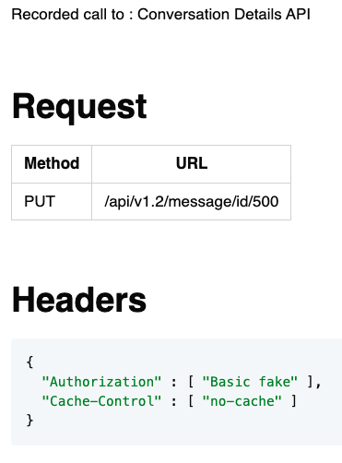
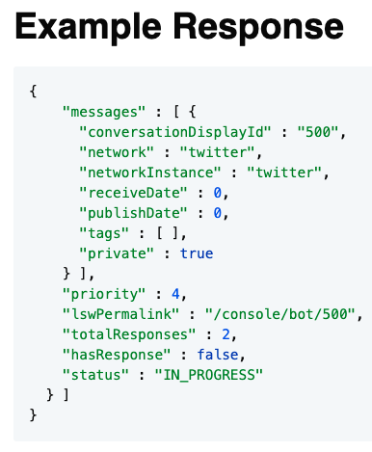
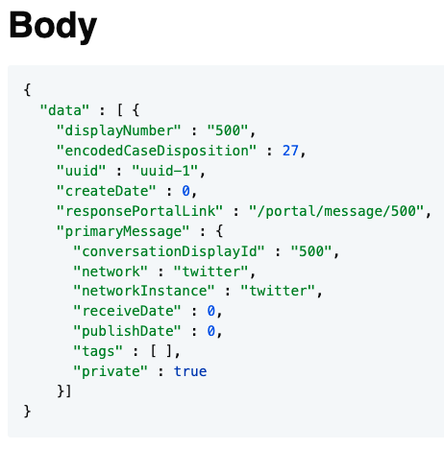
Approval Markdown
2-5 min - Lightning talk?

